Slide 1
Data Spark : Illuminating Insights for Global Electronics
By
Gengatharan L

Slide 2
PROBLEM STATEMENT
As part of Global Electronics' data analytics team, you are tasked with conducting a comprehensive Exploratory Data Analysis (EDA) to uncover valuable insights from the company’s data. Your goal is to provide actionable recommendations to enhance customer satisfaction, optimize operations, and drive overall business growth.
Global Electronics, a leading consumer electronics retailer, has provided several datasets containing information about their customers, products, sales, stores, and currency exchange rates. The company seeks to leverage this data to understand its business better and identify areas for improvement.

Slide 3
DATASETS
The following five datasets are given below:
Customers details
Products details
Sales details
Stores details
Exchange rates

Slide 4
Data Sources
The following dataset of global-electronics-retailers, this data contains sales information from 01 January 2016 to 20 February 2021.
Customer data analysis: Contains information about customers such as gender, D.O.B, and demographics, used for analyzing customer behavior and segmentation.
Sales data analysis: Includes records of transactions, such as a number of sales, product ID, quantities, order date, delivery date, store ID, and currency essential for understanding sales patterns and performance.
Product data analysis: Lists product details including IDs, names, categories, subcategories, unit prices, and unit costs helping to analyze product performance and trends.
Stores data analysis: Provides information on store locations, IDs, and attributes, useful for examining geographic sales performance and store-related analysis.
Currency exchange rates data analysis: Contains historical exchange rates between different currencies, crucial for analyzing sales and financial data in a global context.

Slide 5
Approach
DATA PREPROCESSING
Checking for missing values and handling them appropriately.
Converting data types where necessary (e.g., numerical values and date-time conversion).
Merging datasets where necessary for analysis (e.g., linking sales data with product and customer data).
DATA MANAGEMENT
Inserting the preprocessed data into an SQL database by creating relevant tables for each data source.
DATA VISUALIZATION
Power BI Visualization
Connecting SQL to Power BI/Tableau, importing the data, and creating interactive dashboards.
Develop SQL and DAX Queries
Formulating and executing SQL and Dax queries to extract key insights from the data.

Slide 6
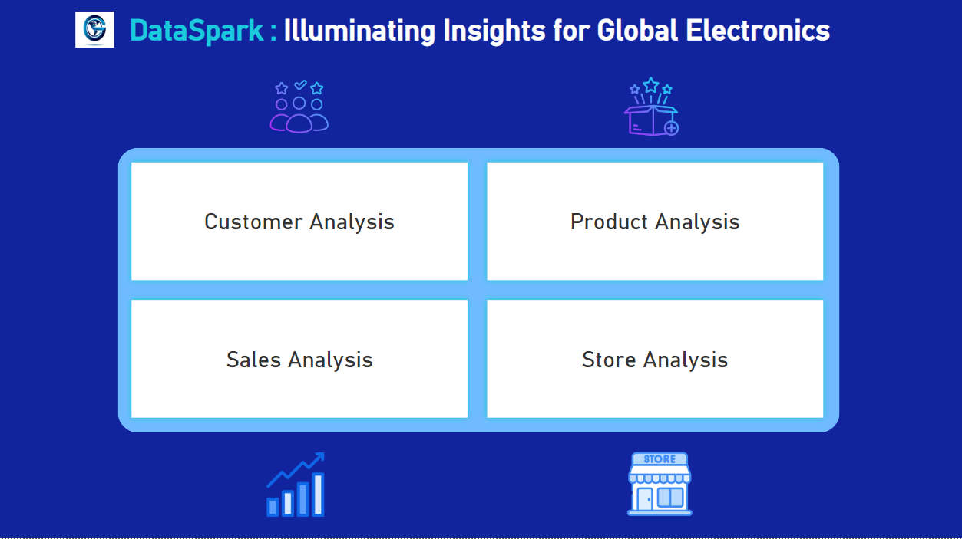
DATA SPARK DASHBOARD

Slide 7
Customer Analysis
Demographic Distribution: Analyze the distribution of customers based on gender, age (calculated from birthday), and location (city, state, country, continent).
Purchase Patterns: Identify purchasing patterns such as average order value, frequency of purchases, and preferred products.
Segmentation: Segment customers based on demographics and purchasing behavior to identify key customer groups.

Slide 8
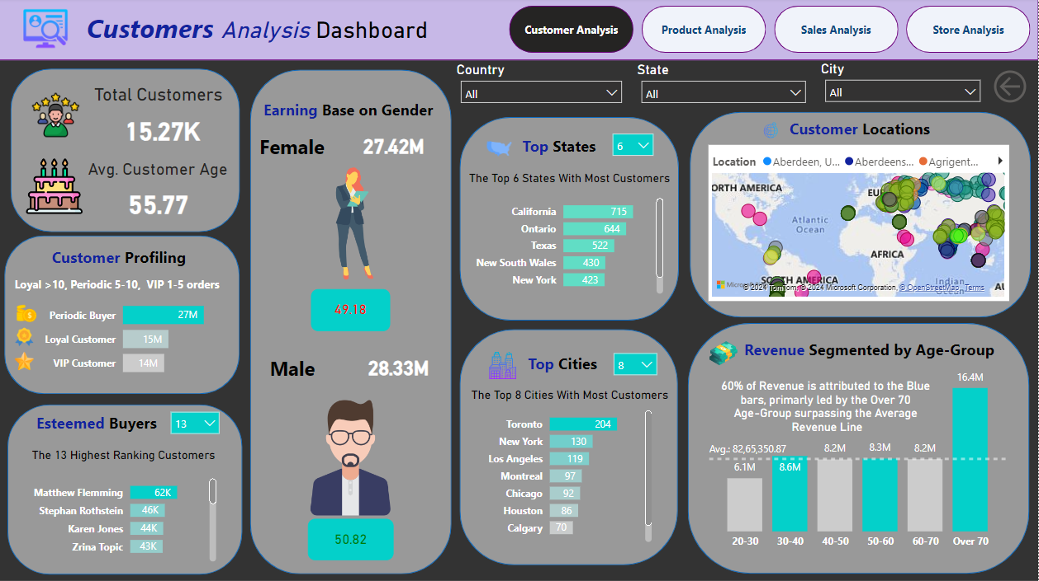

Slide 9
Product Analysis
Product Popularity: Identify the most and least popular products based on sales data.
Profitability Analysis: Calculate profit margins for products by comparing unit cost and unit price.
Category Analysis: Analyze sales performance across different product categories and subcategories.

Slide 10
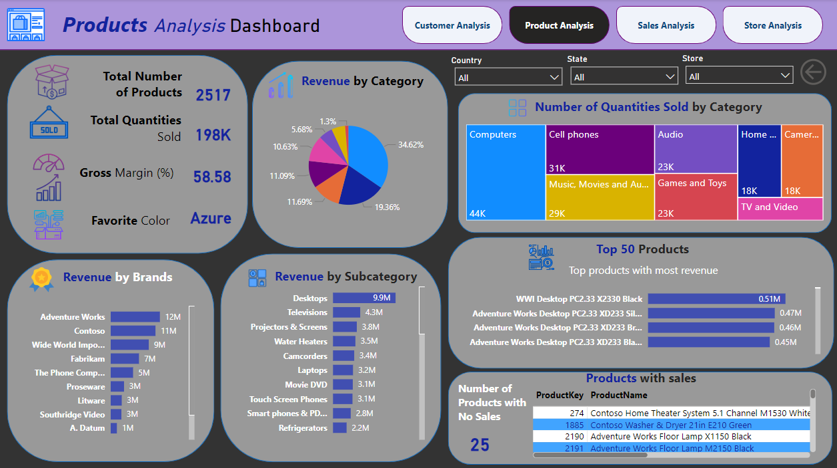

Slide 11
Sales Analysis
Overall Sales Performance: Analyze total sales over time, identifying trends and seasonality
Sales by Product: Evaluate which products are the top performers in terms of quantity sold and revenue generated.
Sales by Store: Assess the performance of different stores based on sales data.
Sales by Currency: Examine how different currencies impact sales figures, considering exchange rates.

Slide 12
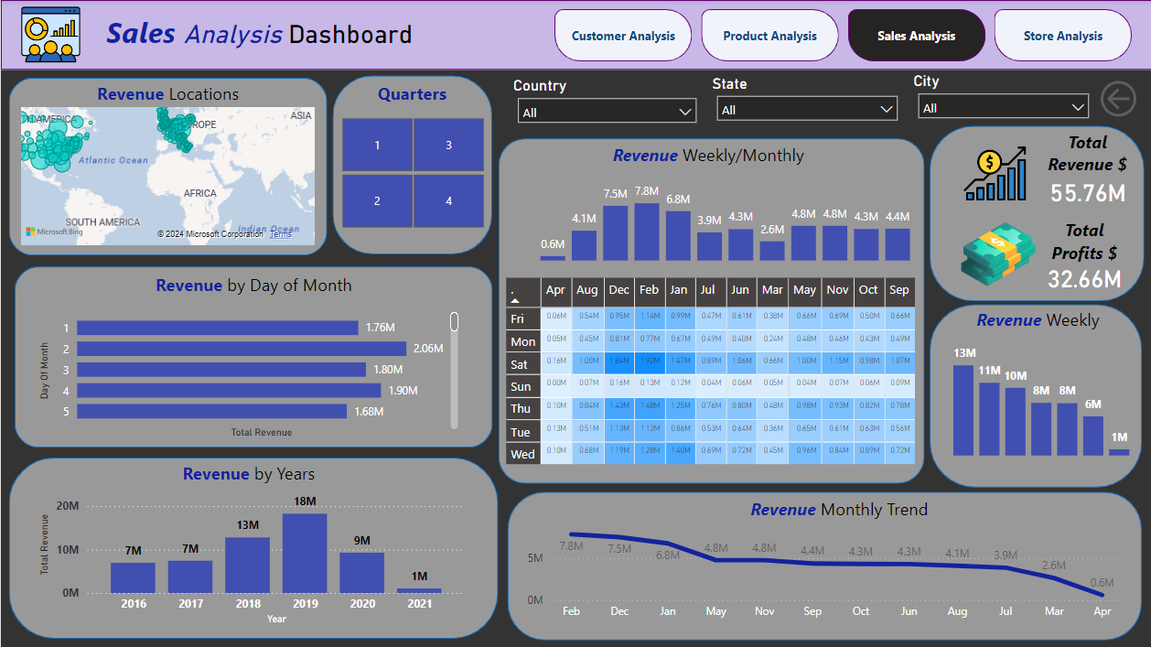

Slide 13
Store Analysis
Store Performance: Evaluate store performance based on sales, size (square meters), and operational data (open date).
Geographical Analysis: Analyze sales by store location to identify high-performing regions.

Slide 14
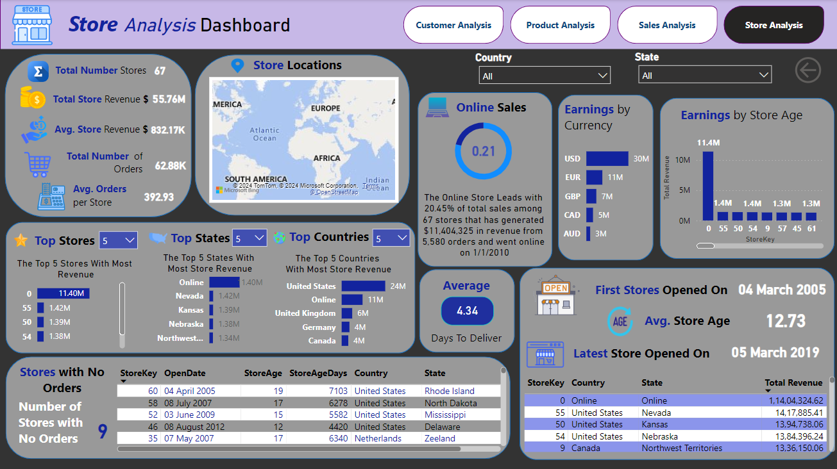

Slide 15
REPORT SUMMARY
The analysis results are summarized as follows:
1. Gender and country-wise: There is no notable variation in customer distribution across different gender categories. However, the United States has the highest number of customers compared to other countries.
2. City-wise: It is evident that several cities in the United States rank among the top ten cities with the highest number of customers. Notably, Toronto leads the list, followed by Montreal and Calgary, indicating a significant interest in our products within these Canadian cities as well.
3. State-wise: Analysis also shows strong customer bases in major U.S. states, as well as significant interest from Canada and Germany. This provides valuable insights into market concentration and potential areas for targeted engagement and expansion.
4. Customers with No Orders: There are 3379 customers with no orders that could generate around an additional revenue of 15 million USD with targeted campaigns.
5. Age-wise: The analysis reveals that the majority of customers are aged 60 and above. This demographic trend suggests a significant interest and engagement from older adults.
6. Frequency of customer visits: Most customer visits around 5 to 10, while the visitors between 1 to 5 and >10 are split evenly. Based on customer engagement levels, we can create targeted marketing campaigns that resonate with different segments, thereby enhancing customer engagement and optimizing advertising efforts.
7. Currency wise: We can infer that most customers use USD, with significant numbers also using EUR and GBP indicating their region as well. Also, there is notable interest from Canadian and Australian markets, indicating a diverse international customer base. Regarding exchange rates, there is an indication that changes in exchange rates for AUD, CAD, EUR, and GBP have minimal to no effect on the revenue in USD.
8. Category and subcategory wise: Computers lead this category with 41.75% of orders numbering 10,990 among 8 categories and have generated 19 million USD or 36.62 %. The subcategory Desktops leads the subcategory as well with 9.9 million USD in revenue.
9. Brand wise: Adventure Works, Contoso, and Wide World Importers lead the brand’s section, making more than 5 million USD each.
10. Product wise: The top product sold was WWI Desktop PC.33 X2330 Black selling 550 quantities and making around .51 million USD. This is followed by desktop products from Adventure Works as well in the top 5 making around 0.40 million USD each.
11. Store Wise: The Online Store leads with 20.45% of total sales among 67 stores and has generated around 11 million USD.
12. Store age and size: There is no correlation between the revenue and store's age and store's size.
13. Stores with No orders: There are 9 stores with no orders, these stores could either include targeted campaigns or be closed to focus more on online sales as it spearhead the sales.
14. Time analysis: From 2016 to 2019, the sales revenue exhibited a consistent upward trend. During this period, the revenue increased annually, reflecting positive business performance and successful market strategies. In 2020, there was a notable decline in sales revenue. The decrease could be associated with economic downturns, or supply chain disruptions due to the Covid-19 pandemic. For the year 2021, revenue data is only available up to February. However, the early data for 2021 suggests that the revenue challenges have continued into the new year. Further, it can be inferred from all the years that the lowest-performing month is April with the top 3 being December, January, and February.

Slide 16
THANK YOU

